Slide 1
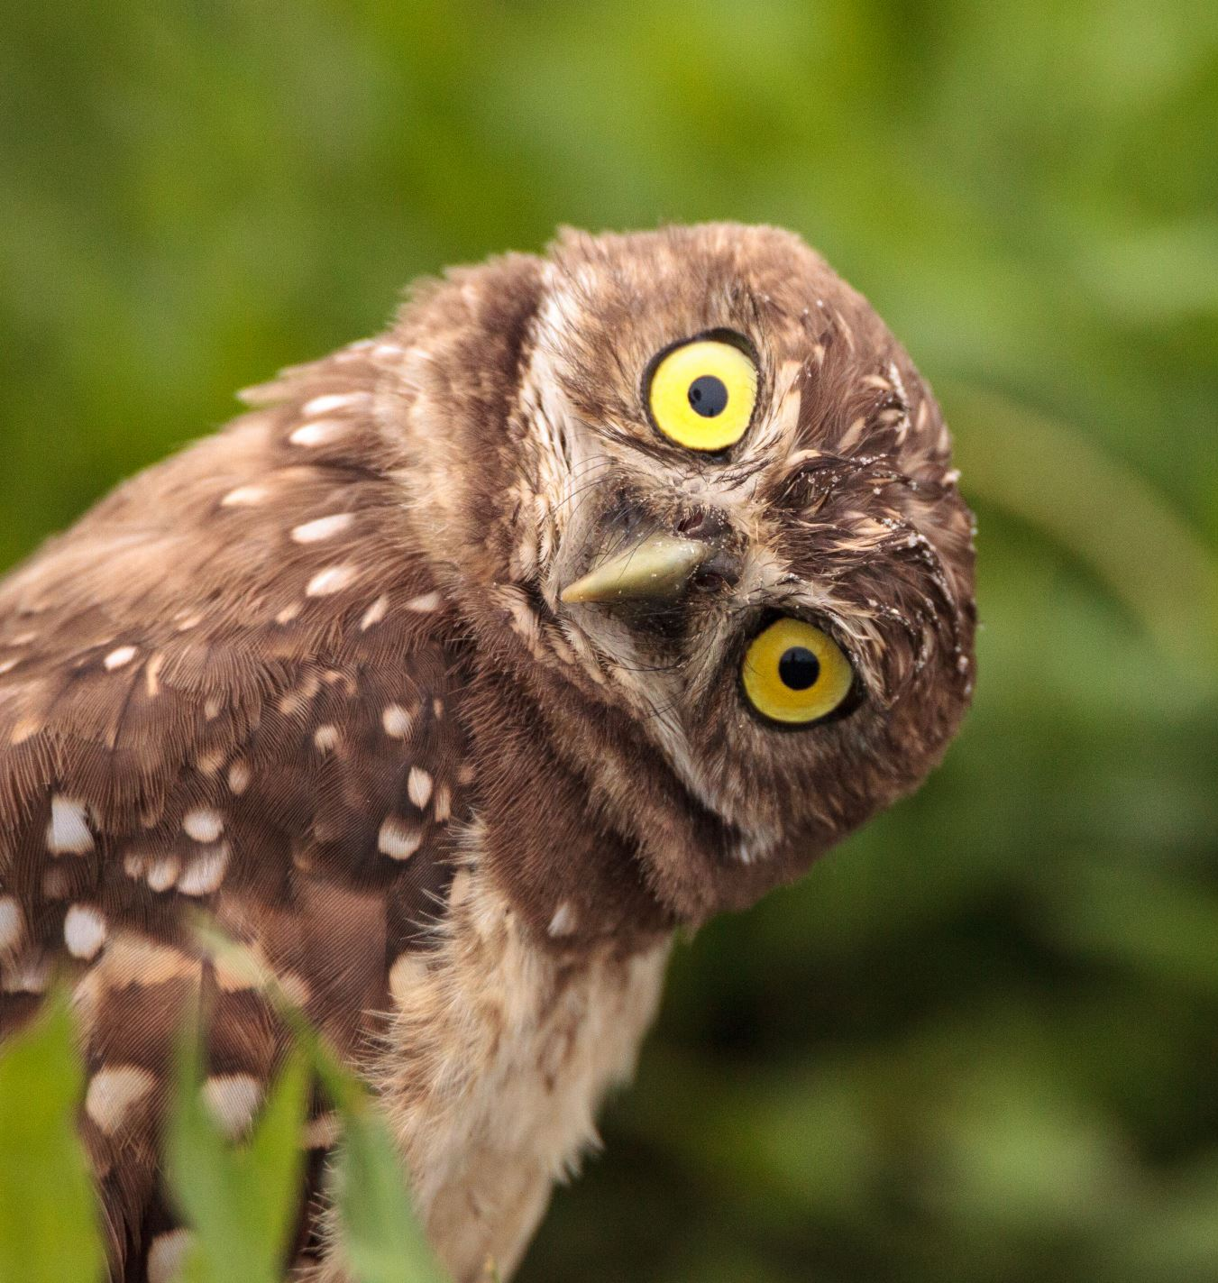

BIRDS 525 SPECIES
QUANT SQUAD
IMAGE CLASSIFICATION
https://www.kaggle.com/datasets/gpiosenka/100-bird-species

Slide 2
Data Quality and Cleaning
90.000 pictures (224x224 pixels)
84.635 train images
2.625 test images
2.625 valid images
525 unique classes
1 wrong folder name (2 spaces in the name instead of 1)
1 Easter Egg…

Slide 3
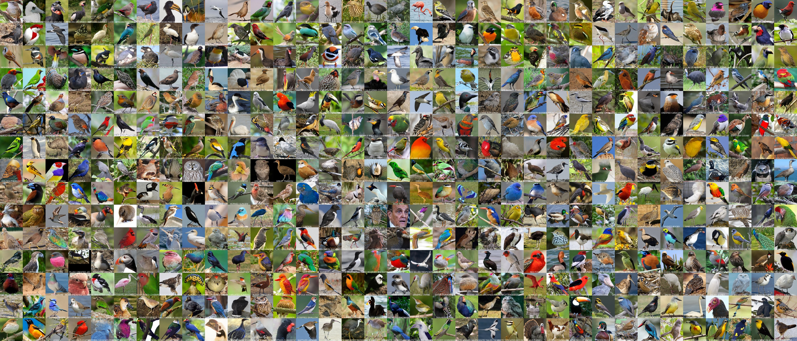
Birds 525 species

Slide 4
Birds 525 species

Slide 5
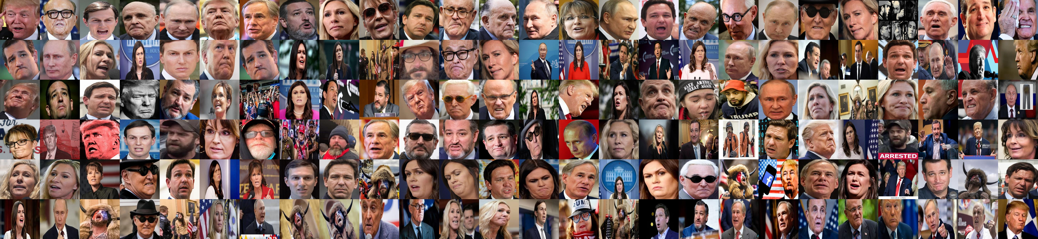
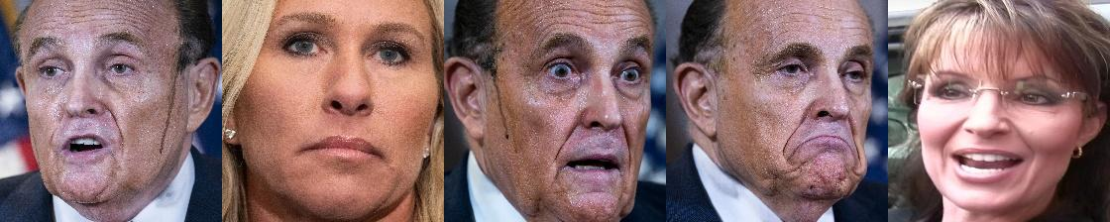
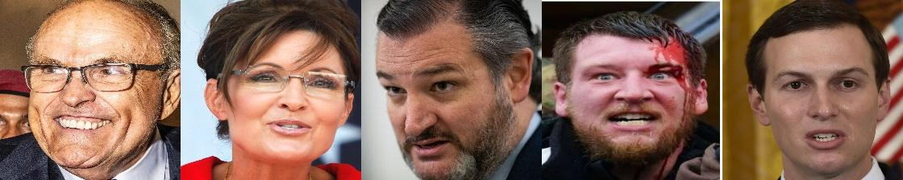
Easter egg ☺
Looney Birds
Training images
Test images
Validation images

Slide 6
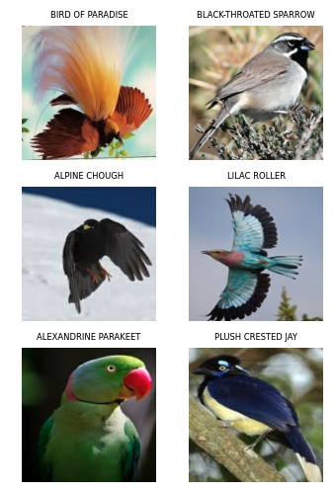
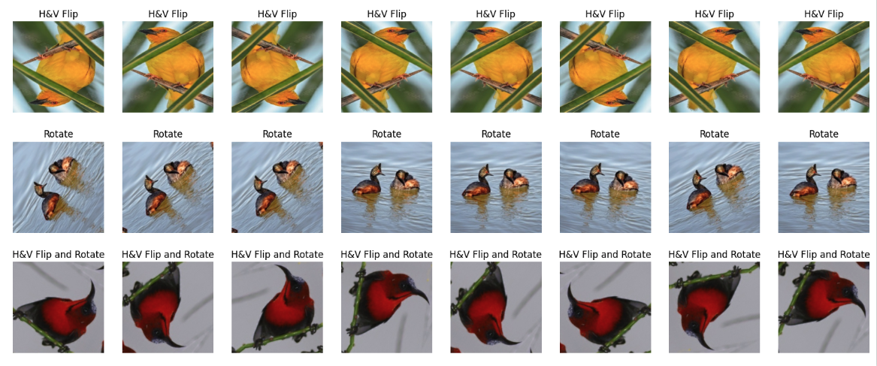
Data Augmentation
Original data
Data with different augmentation method
RandomFlip – Horizontal & Vertical
RandomRotation – 0.2

Slide 7
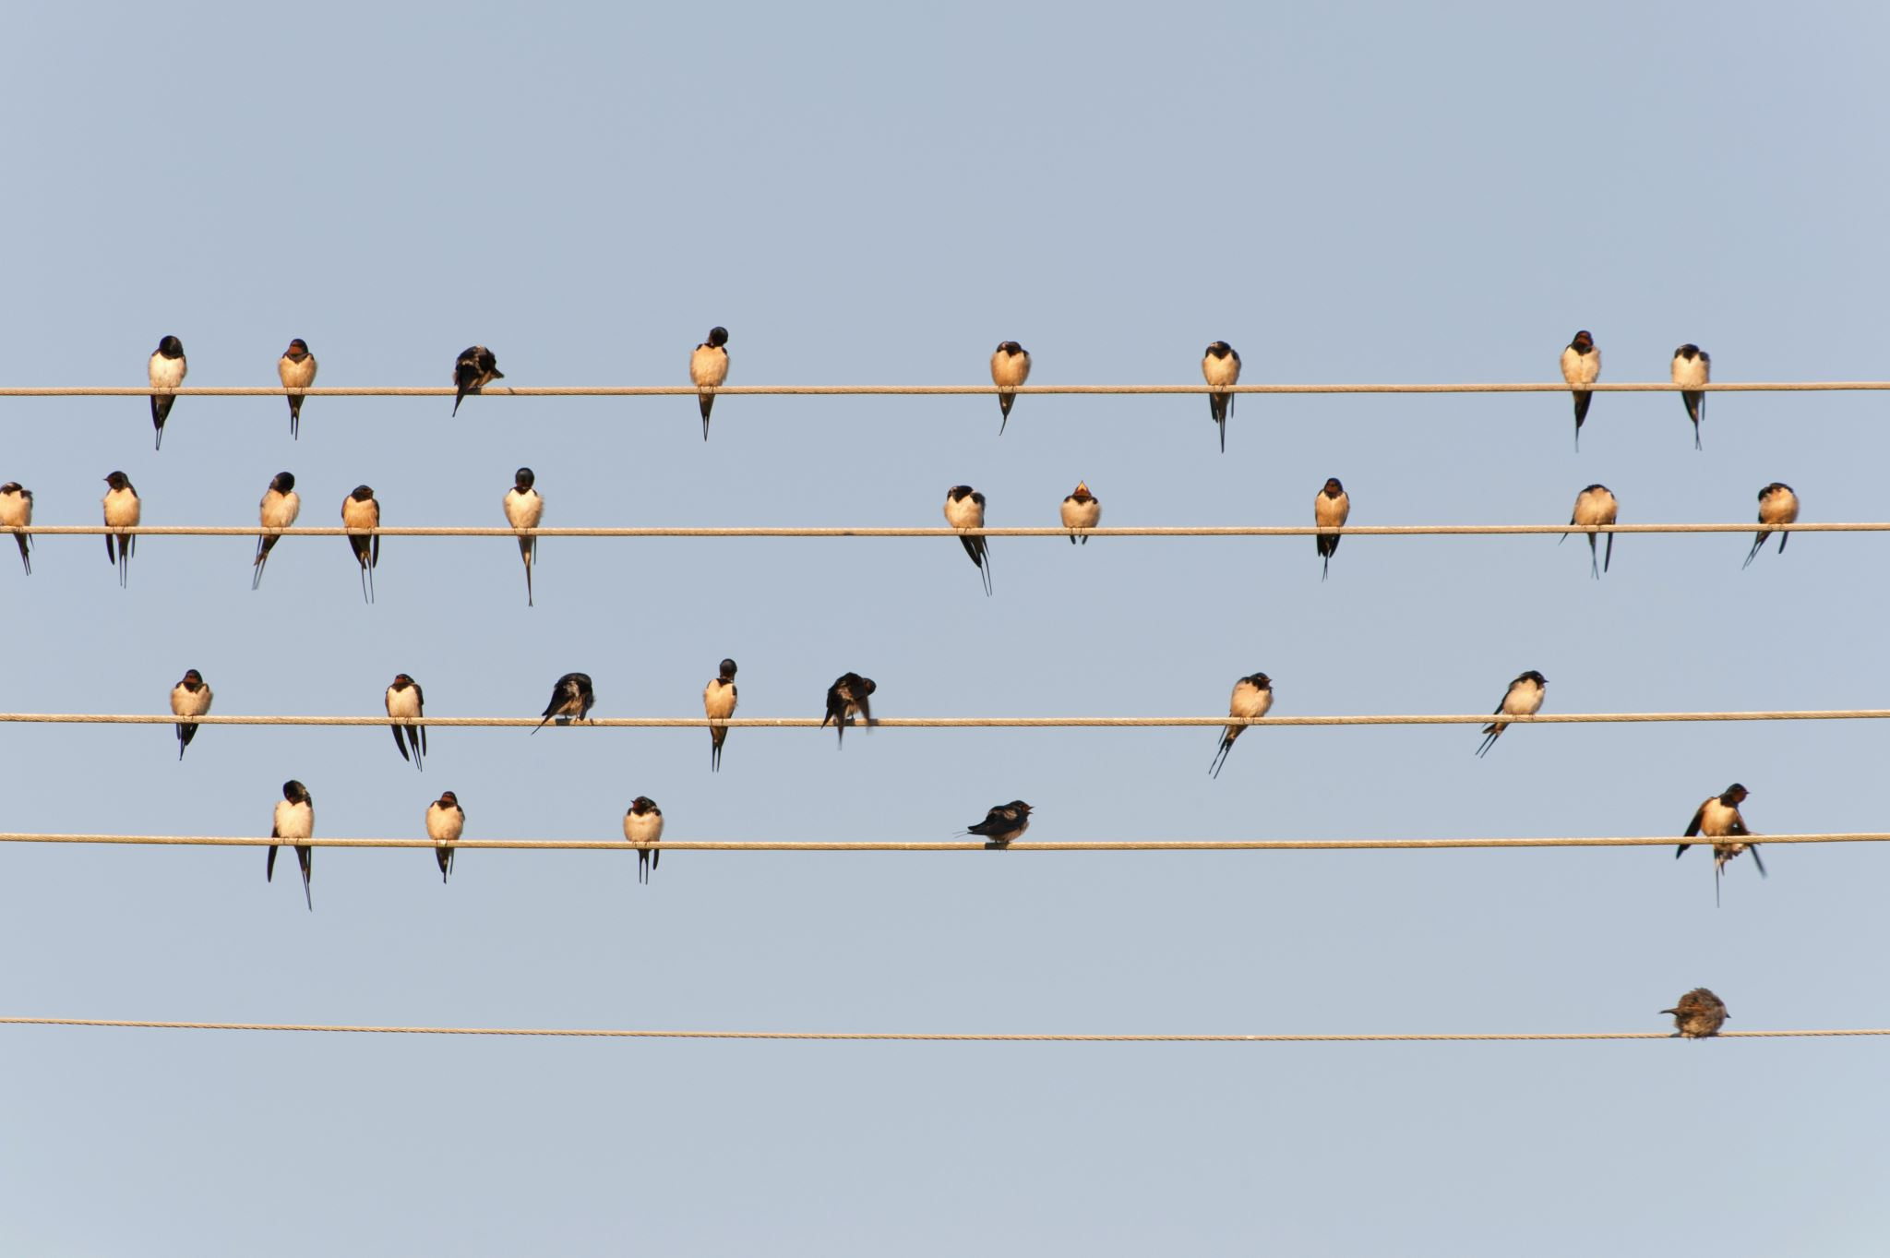
Our Models
Quant-Squad-M01 (Own model)
Quant-Squad-M02 (used ResNet50-v2 as base model)
Quant-Squad-M03 (used EfficientNetB0 as base model)
Quant-Squad-M04 (used EfficientNetB2_v2 as base model)

Slide 8
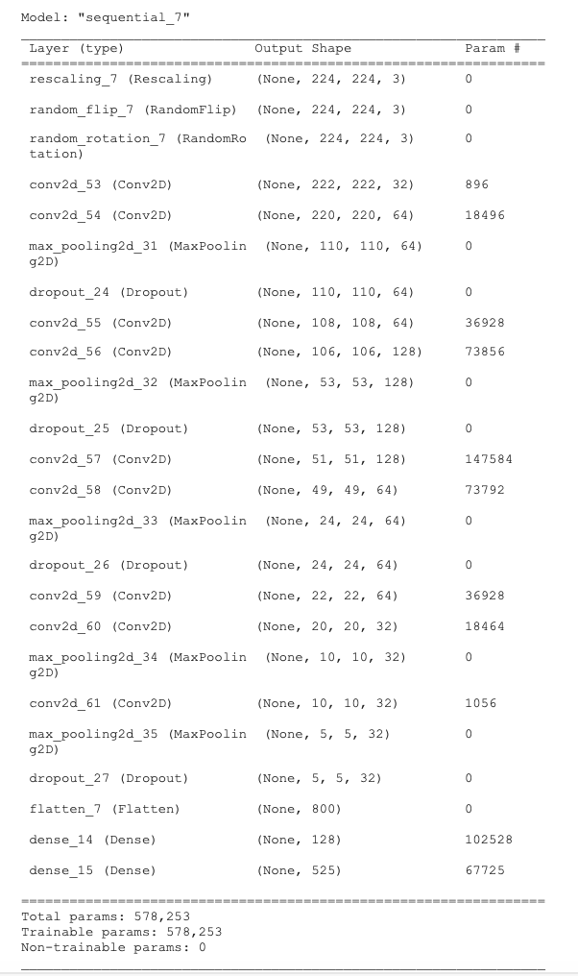
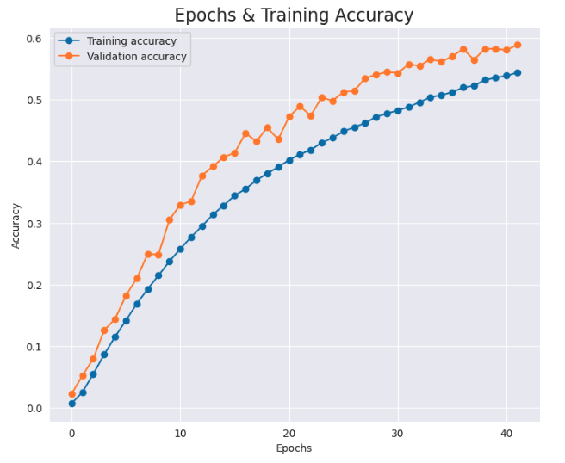
Model: Quant-Squad-M01
Own model – Simple CNN
Train: loss: 1.8983 - accuracy: 0.5440

Slide 9
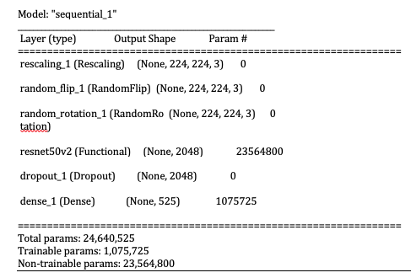
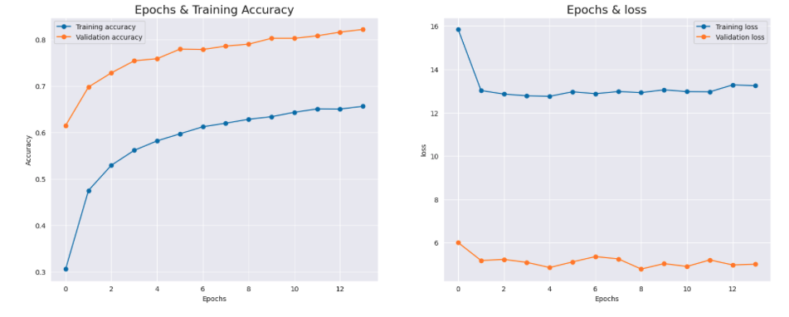
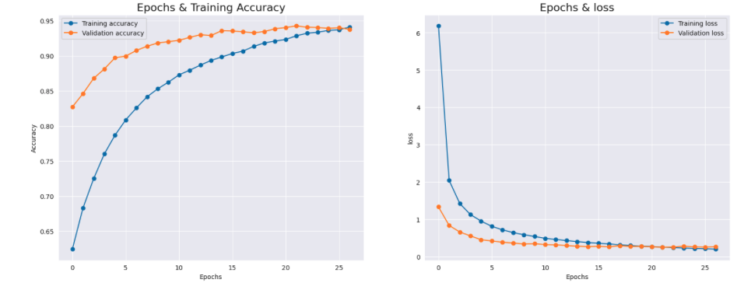
Model: Quant-Squad-M02
Base - ResNet50_v2
Train: loss: 13.2472 - accuracy: 0.6564
Fine-tuning: loss: 0.2089 - accuracy: 0.9409

Slide 10
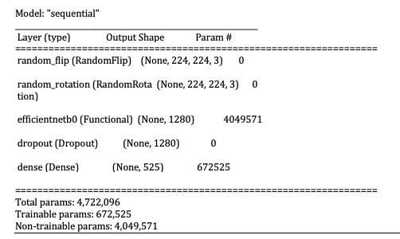
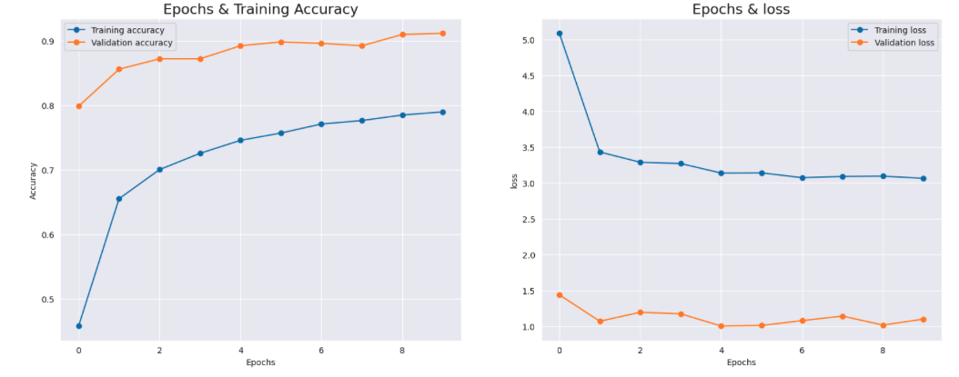
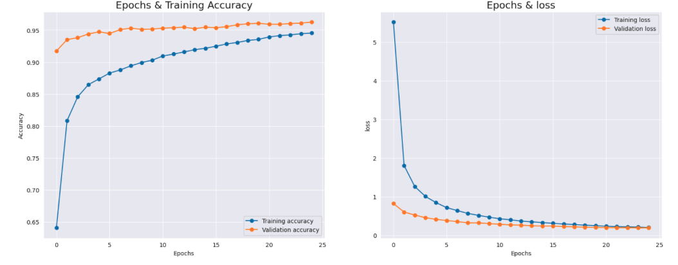
Model: Quant-Squad-M03
Base - EfficientNet_B0
Train: loss: 3.0661 - accuracy: 0.7898
Fine-tuning: loss: 0.1998 - accuracy: 0.9455

Slide 11
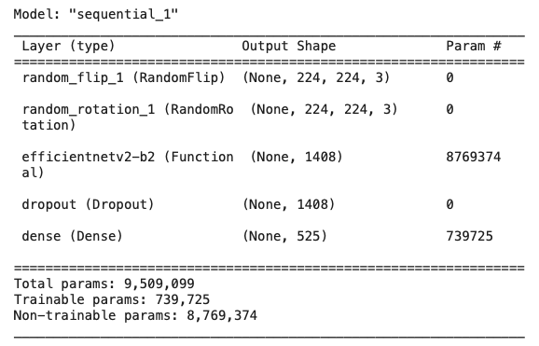
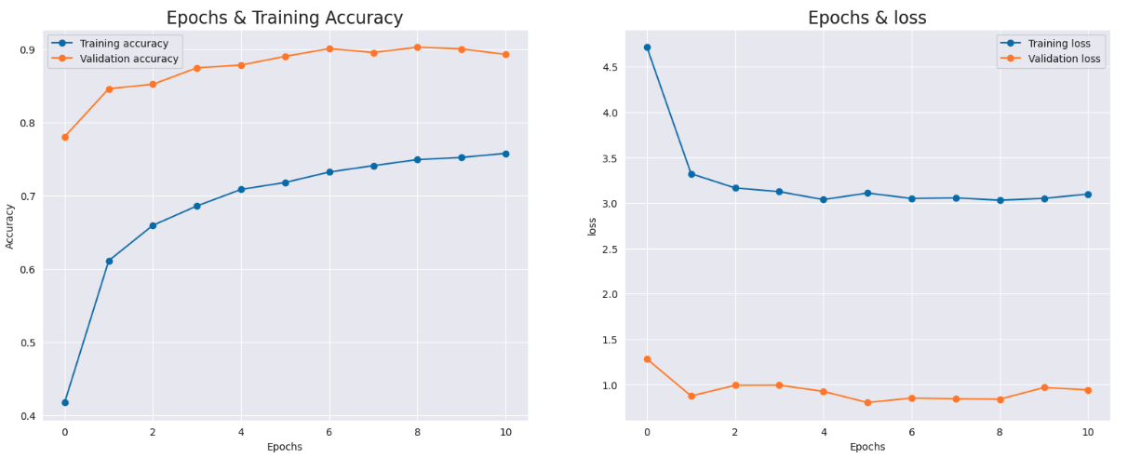
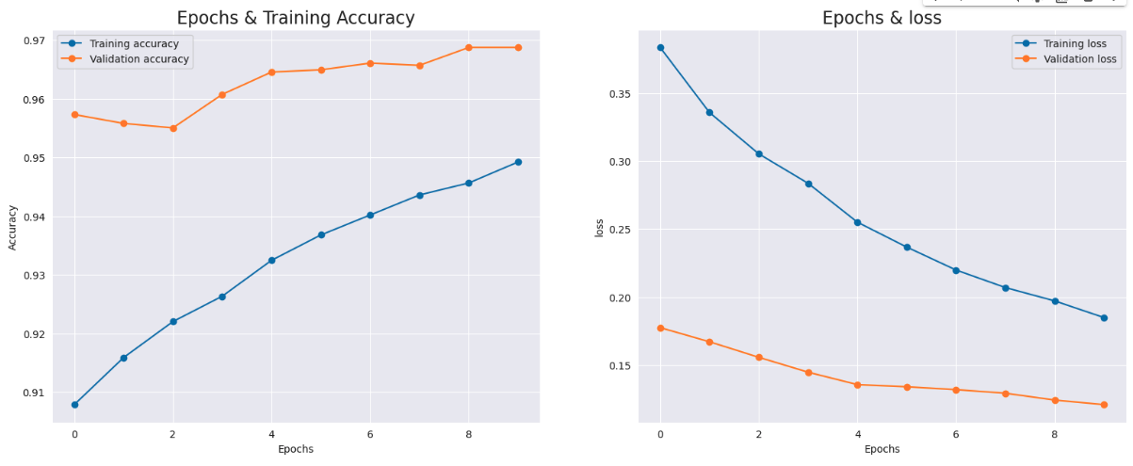
Model: Quant-Squad-M04
Base - EfficientNet_B2_v2
Train: loss: 0.3.0978 - accuracy: 0.7578
Fine-tuning: loss: 0.1848 - accuracy: 0.9492

Slide 12
Quant-Squad Models Accuracy & Loss

Slide 13
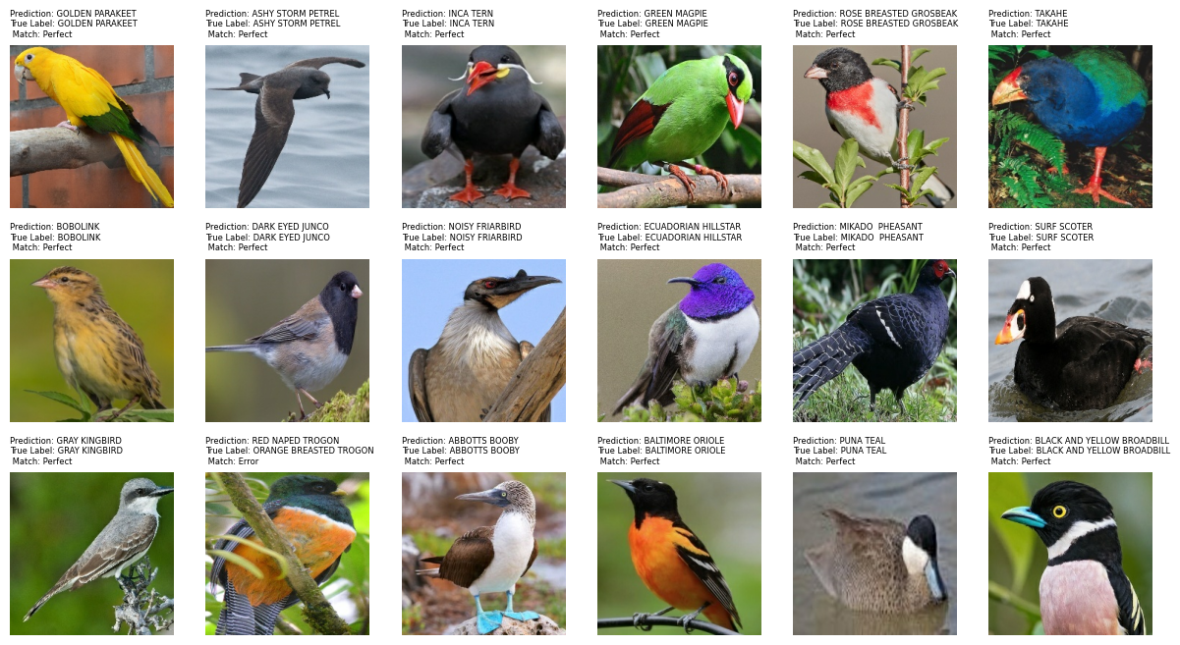
Best Model Validation on Test data

Slide 14
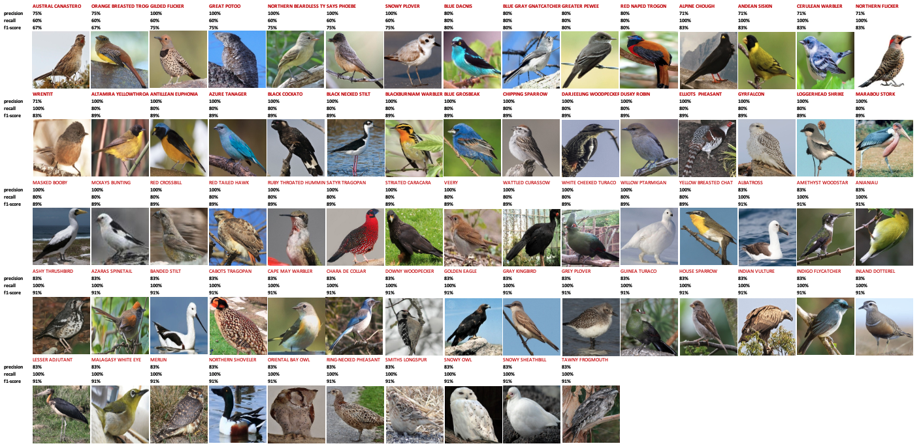
Best Model Imperfection
93% has precision 100%
93% has recall 100%
87% has f1-score 100%

Slide 15
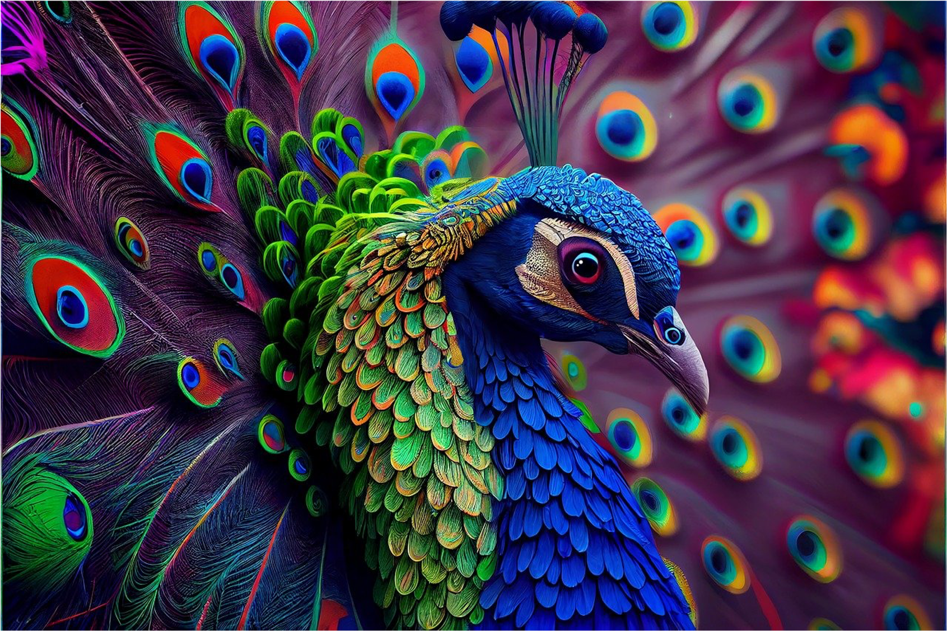


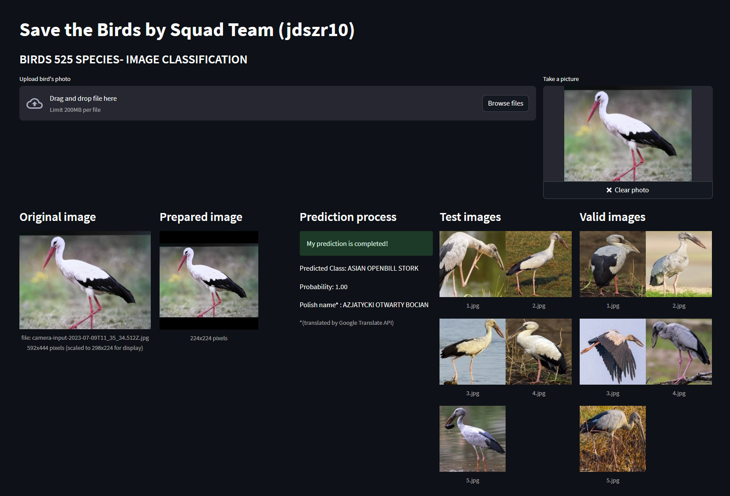
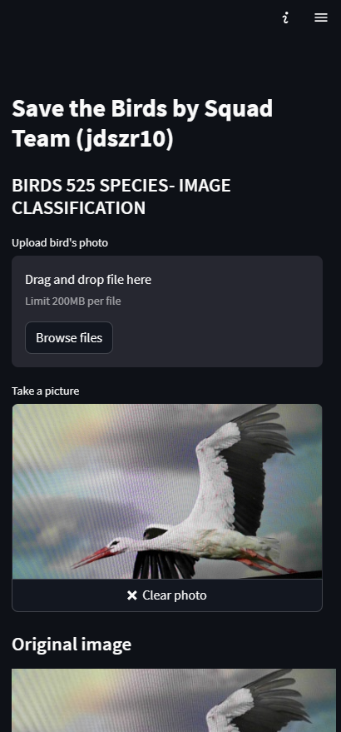
Our Product: Save the Birds Live!
Application

Slide 16
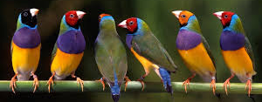
Conclusions
Building the best model for the project requires a repeated attempts and testing
CNN's own model was less efficient than predefined models for large data sets
Fine-tuning allowed to achieve better results of model output
DL models required hours of calculations, so equipment parameters are key to achieve good results - consider doing calculations in the cloud (e.g. using Google Colab)

Slide 17
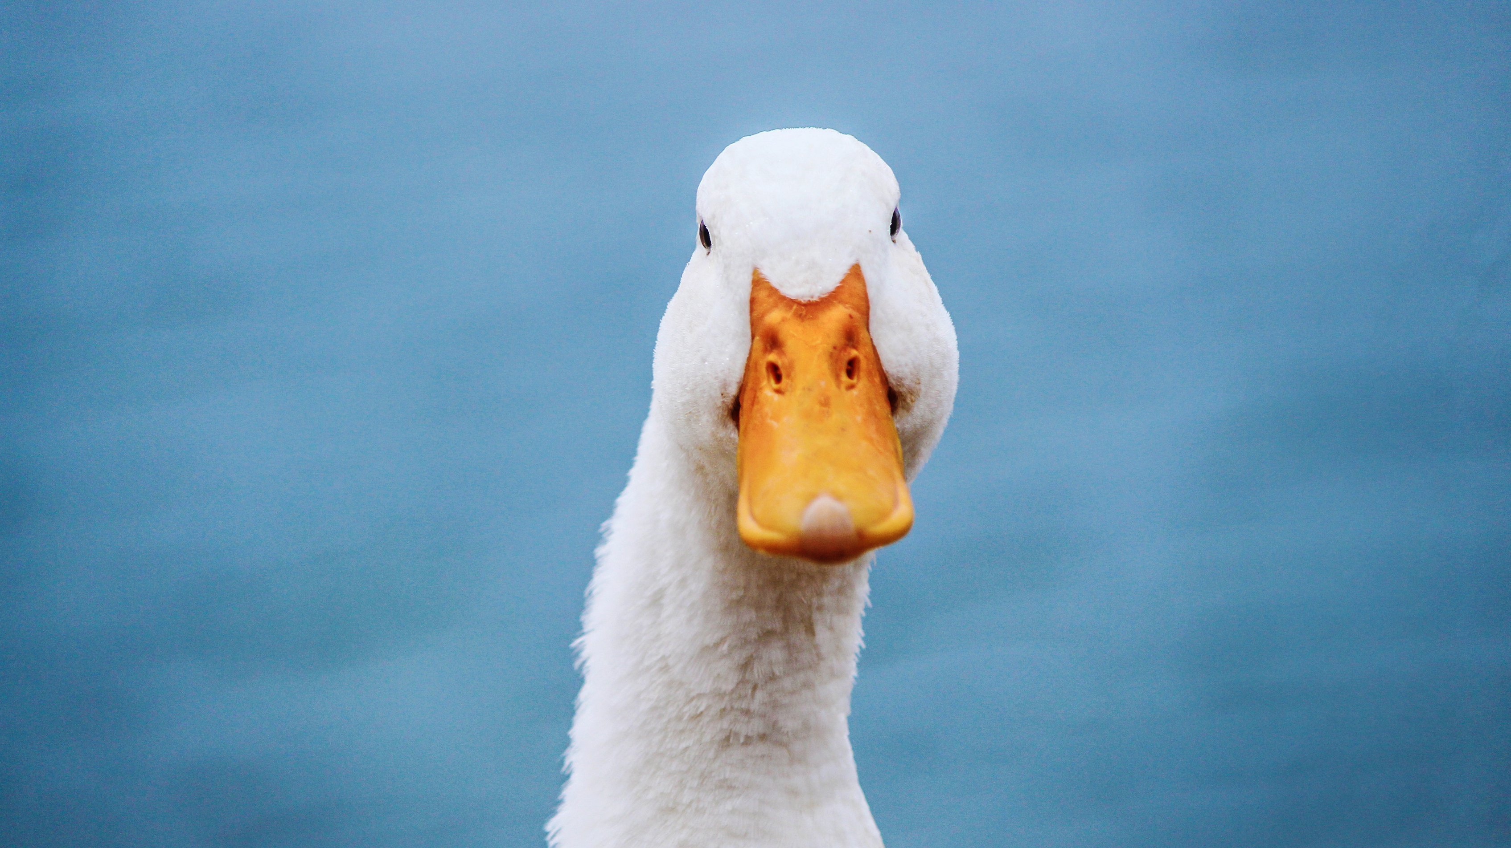
THE END

